Slide 1
CSE3021
Social and Information Networks
FACULTY: PUNITHA K – SCOPE
SLOT: B2 + TB2
PROJECT REVIEW 2
TEAM MEMBERS:
AAKASH AGGARWAL-18BLC1060
MILLENA DEBAPRADA JENA-18BCE1030

Slide 2
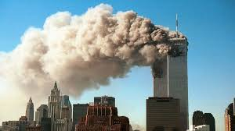
EXAMINING AND ANALYISING 9/11 ATTTACK AS A SOCIAL NETWORK

Slide 3
ABSTRACT
This project looks at mapping covert networks using data available from news sources on the World Wide Web. Specifically, we examine the network surrounding the tragic events of September 11th 2001. Through public data we are able to map a portion of the network centered on the 19 dead hijackers. This map gives us some insight into the terrorist organization, yet it is incomplete. Suggestions for further work and research are offered.
Famous dataset of the terrorists involved in the 9/11 bombing of the World Trade Centres in 2001. Data was extracted from news reports and ties range from at school with to on same plane. Ties are undirected and binary. Relations are a mix of prior-contacts like trained together, lived together, financial transactions, at school with, on same flight

Slide 4
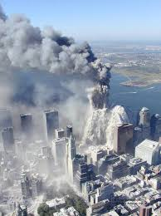
INTRODUCTION AND BACKGROUND

Slide 5
We were all shocked by the tragic events of September 11, 2001. In the non-stop stream of news and analysis one phrase was continuously repeated - "terrorist network." Everyone talked about this concept, and described it as amorphous, invisible, resilient, and dispersed.
We will set out to map this network of terrorist cells that had so affected all of the lives.
Our aim would be to uncover network patterns that would reveal Al Qaeda's preferred methods of stealth organization. If we know what patterns of organization they prefer, we may know what to look for as we search them out in countries across the world.

Slide 6
DATA SOURCE
Our data sources were publicly released 4 research papers
For guidance we turned to previous work by social network theorists who had studied covert, secret, or illegal networks. We found four excellent papers that formed a working foundation for the knowledge we would use to pursue this project.
Uncloaking Terrorist Network(By Valdis E.Krebs) November 4th-1st April.This Reasearch paper is our main source for our project.This research paper provides us the Complete Dataset required for this project
Malcolm Sparrow (Sparrow, 1991) examines the application of social network analysis to criminal activity. Sparrow describes three problems of criminal network analysis that I soon encountered.
Incompleteness - the inevitability of missing nodes and links that the investigators will not uncover.
Fuzzy boundaries - the difficulty in deciding who to include and who not to include.
Dynamic - these networks are not static, they are always changing.

Slide 7
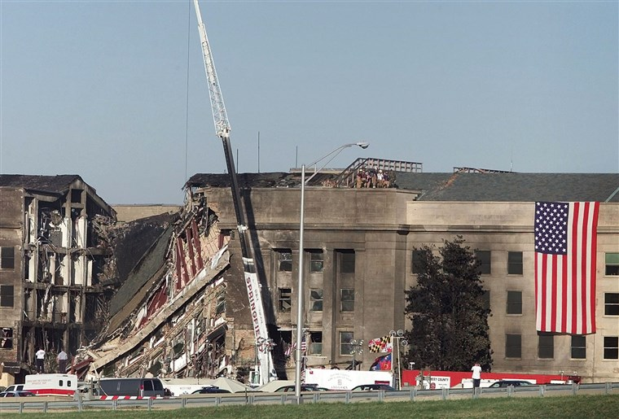
DATA GATHERING

Slide 8
From Uncloaking Terrorist Network(By Valdis E.Krebs) November 4th-1st April.This Reasearc h paper,
Within one week of the attack, information from the investigation started to become public. We soon knew there were 19 hijackers, which planes they were on, and which nation's passports they had used to get into America. As more information about the hijackers' past was uncovered he decided to map links of three strengths (and corresponding thickness). The tie strength would largely be governed by the amount of time together by a pair of terrorists. Those living together or attending the same school or the same classes/training would have the strongest ties. Those traveling together and participating in meetings together would have ties of moderate strength and medium thickness. Finally, those who were recorded as having a single transaction together, or an occasional meeting, and no other ties, he classified as weak ties that were shown with the thinnest links in the network.

Slide 9
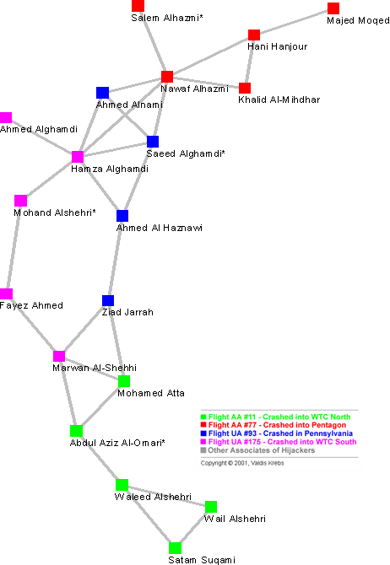

Slide 10
The network metrics for the network in Figure 2 are found in Table 1. For a small network of less than 20 nodes, we see a long average path length of 4.75 steps. Several of the hijackers are separated by more than 6 steps. From this metric and bin Laden's comments above we see that covert networks trade efficiency for secrecy.
 | Clustering Coefficient | Average Path Length
Contacts | 0.41 | 4.75
Contacts + Shortcuts | 0.42 | 2.79

Slide 11
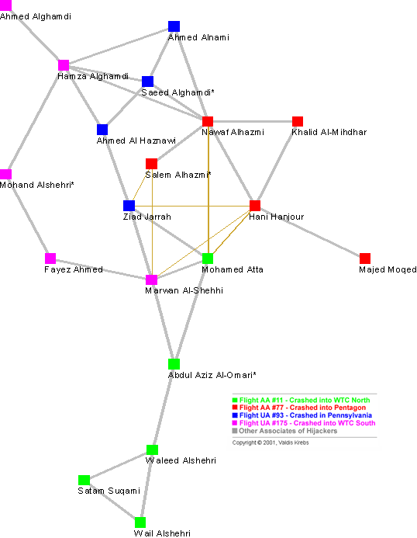

Slide 12
Six (6) shortcuts were added to the network temporarily in order to collaborate and coordinate. These shortcuts reduced the average path length in the network by over 40% thus improving the information flow in the network - see Table 1. When the network is brought closer together by these shortcuts, all of the pilots ended up in a small clique - the perfect structure to efficiently coordinate tasks and activities. There is a constant dynamic between keeping the network hidden and actively using it to accomplish objectives (Baker and Faulkner, 1993).
The 19 hijackers did not work alone. They had other accomplices that did not get on the planes. These co-conspirators were conduits for money and also provided needed skills and knowledge. Figure 4 shows the hijackers and their network neighborhood - their direct and indirect associates.

Slide 13
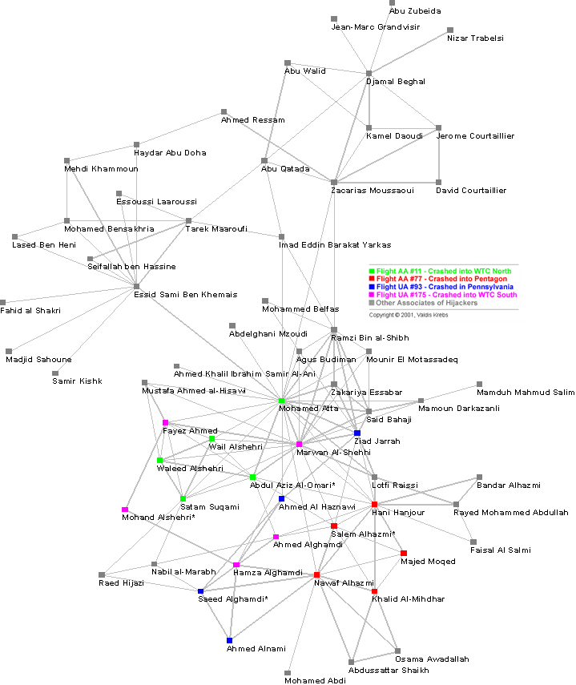

Slide 14
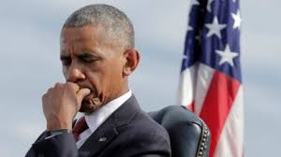
After one month of investigation it was 'common knowledge' that Mohamed Atta was the ring leader of this conspiracy. Again, bin Laden verified Atta's leadership role in the video tape (U.S. Department of Defense, 2001). Looking at the diagram he has the most connections. In Table 2 we see

Slide 15
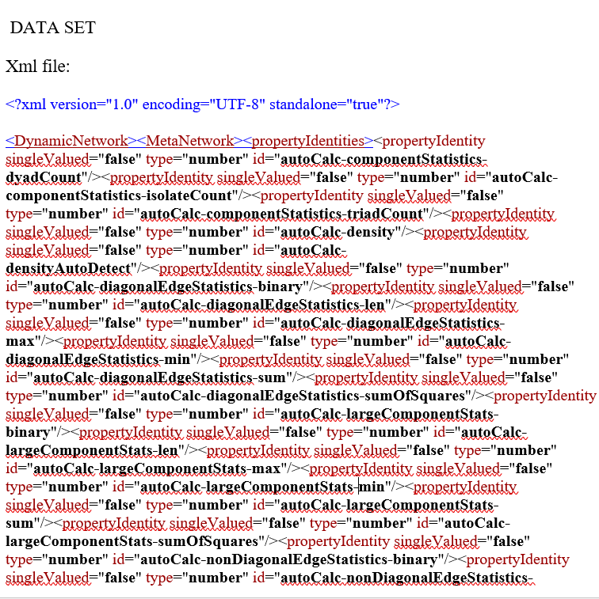

Slide 16
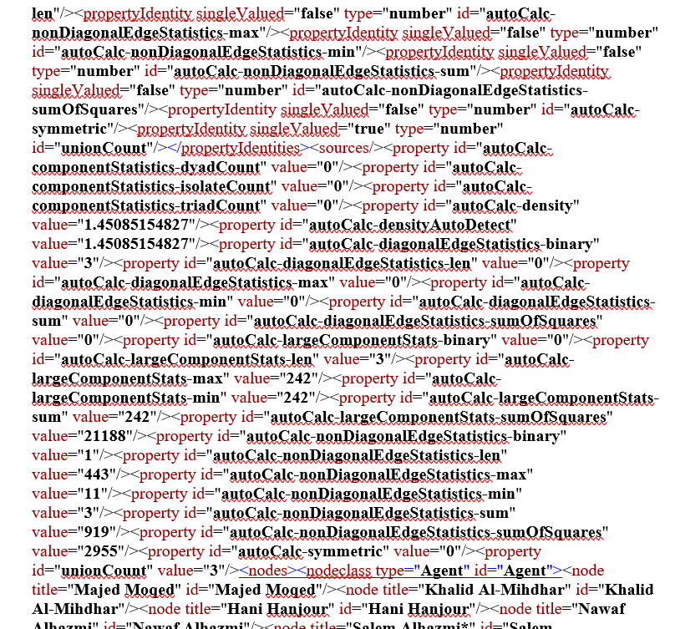

Slide 17
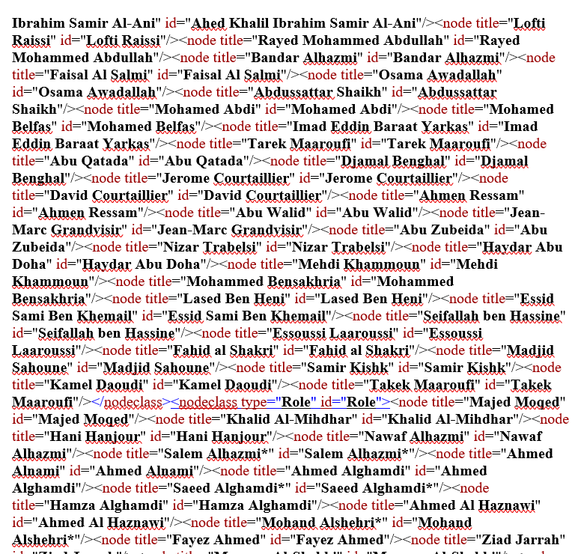

Slide 18
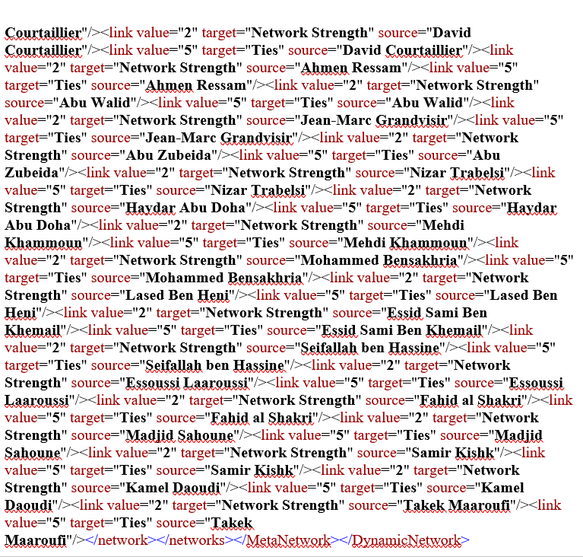

Slide 19
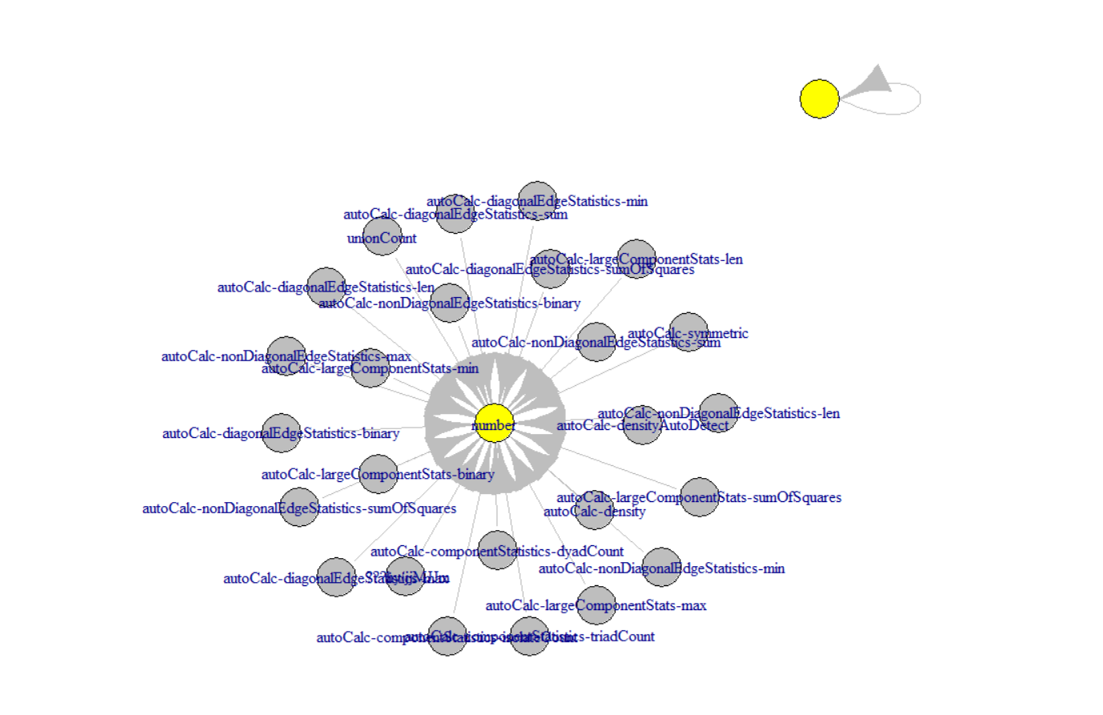

Slide 20
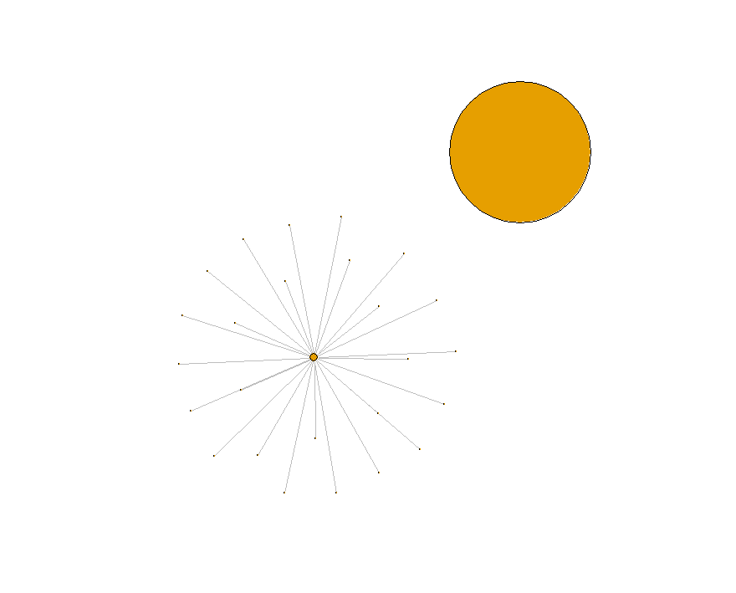

Slide 21
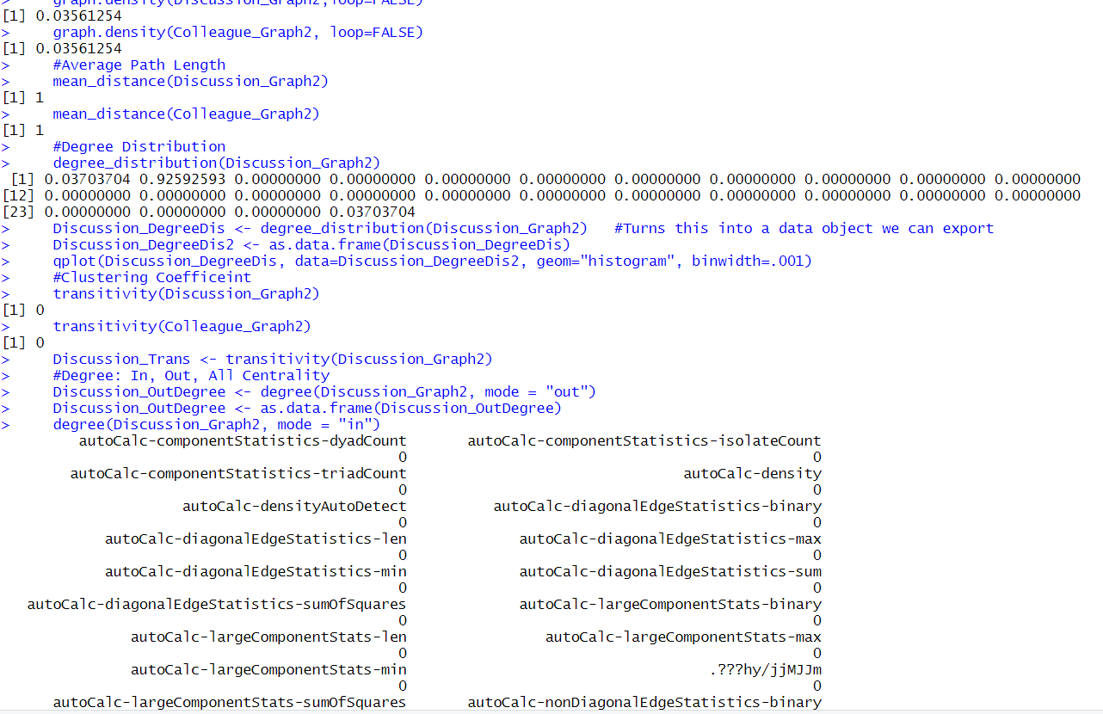

Slide 22
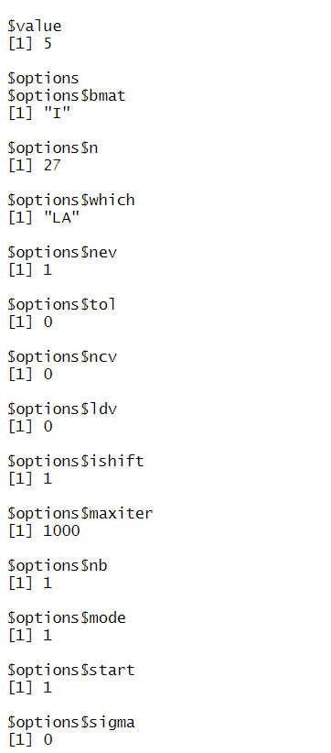
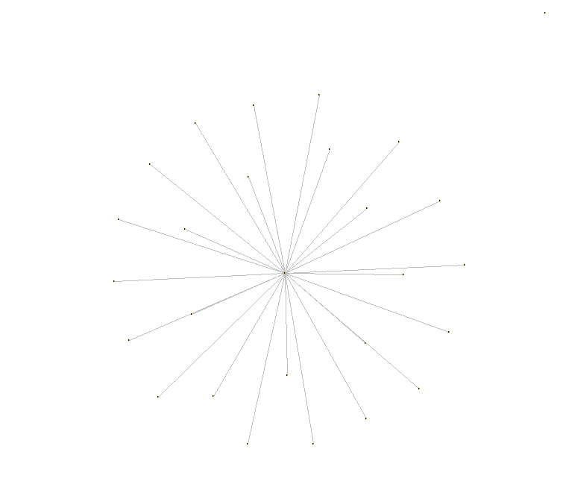

Slide 23
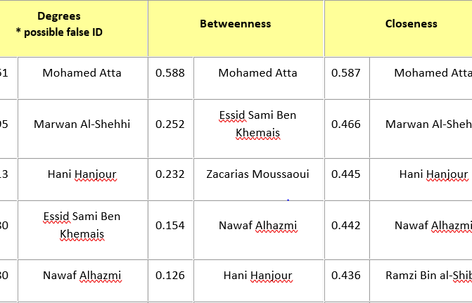
Table 2: Hijacker Network Neighborhood
that Atta scores the highest on all network centrality metrics - Degrees, Closeness, and Betweenness (Freeman, 1979). The network metric Degrees reveals Atta's activity in the network. Closeness measures his ability to access others in the network and monitor what is happening.

Slide 24
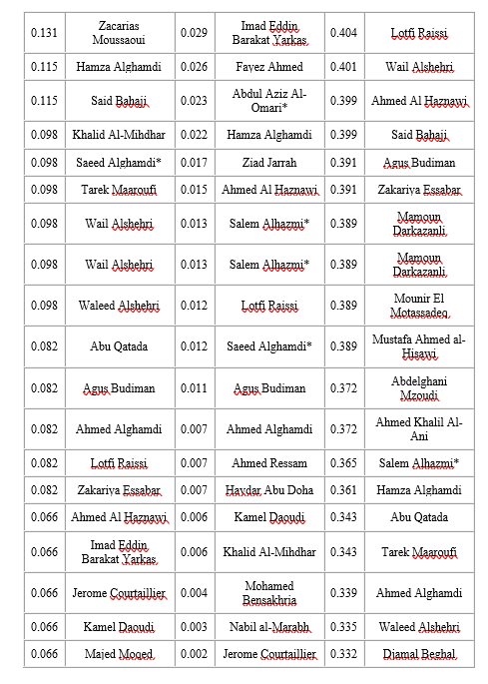
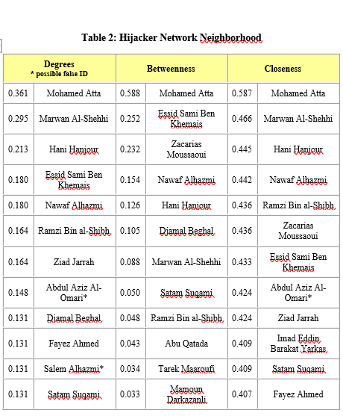

Slide 25
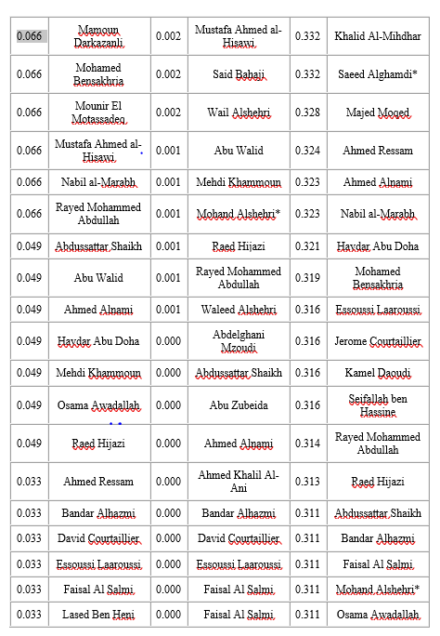
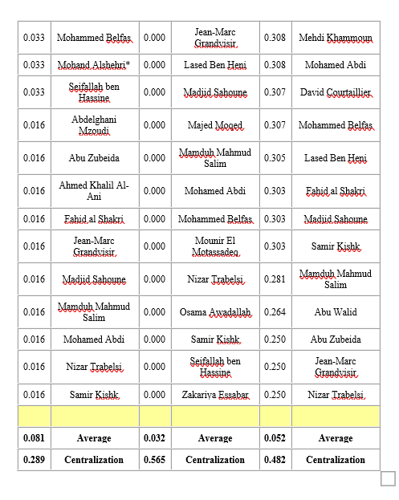

Slide 26
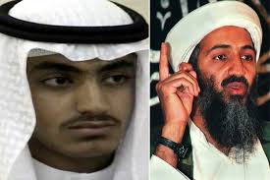
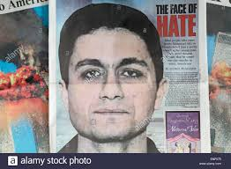
Betweenness shows his control over the flow in the network - he plays the role of a broker in the network. These metrics support his leader status.

Slide 27


